Slide 1
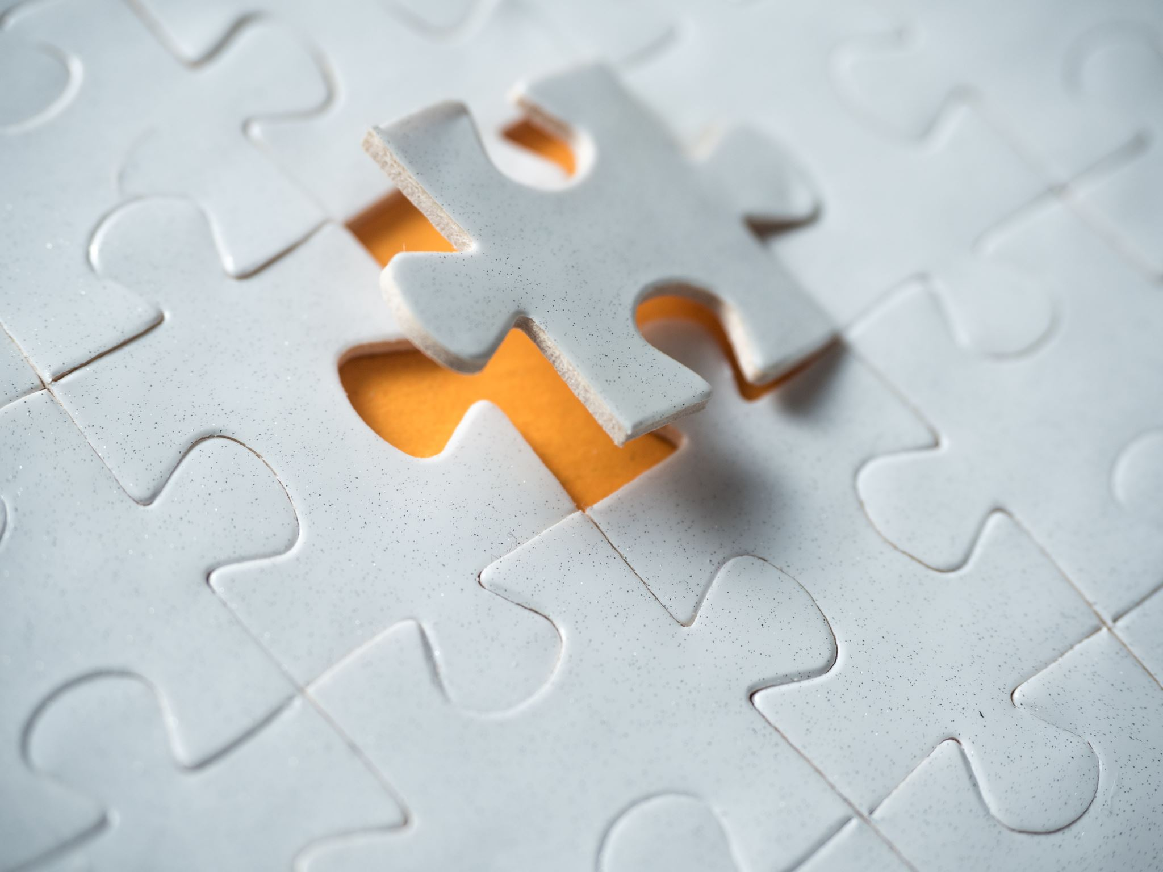
Unsupervised Learning of Visual Representations by Solving Jigsaw Puzzles

Slide 2
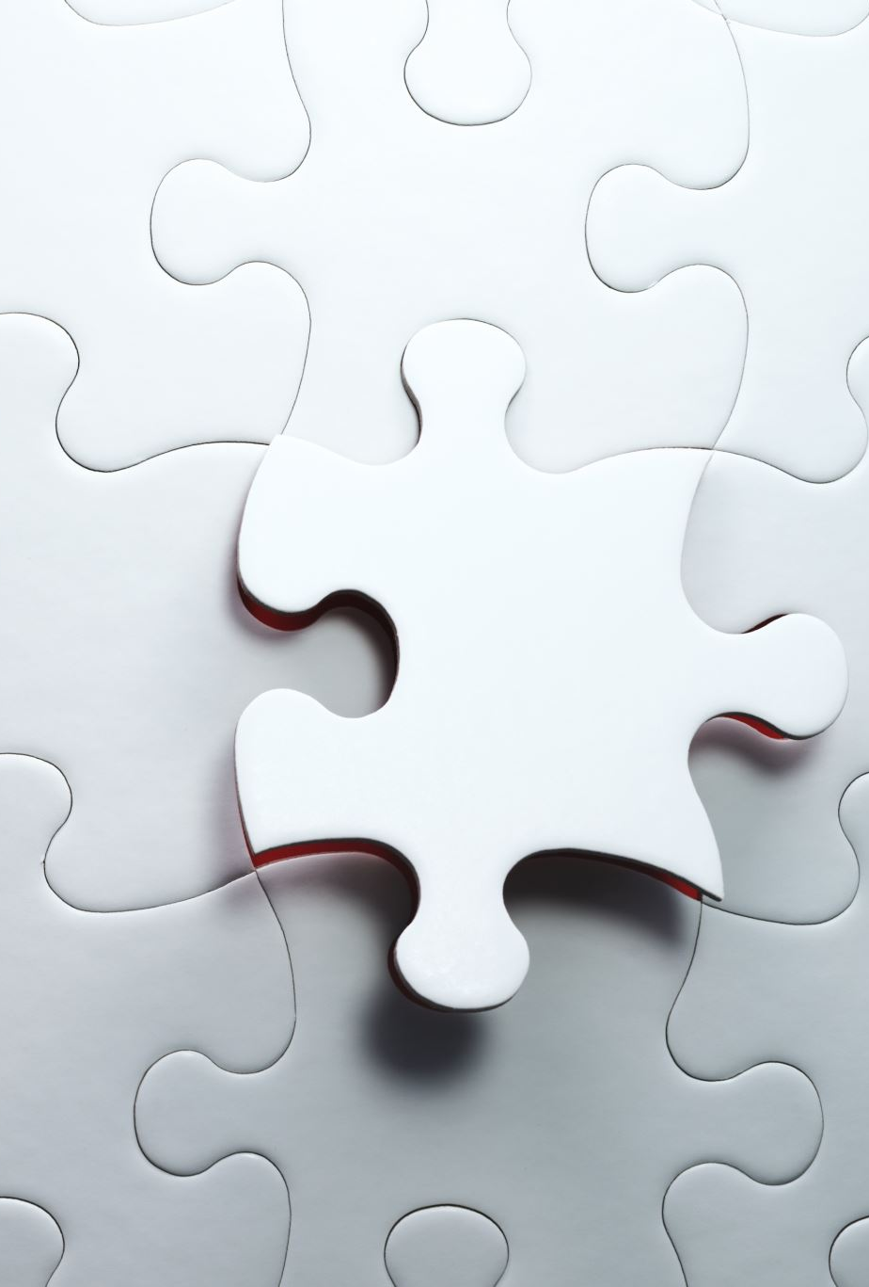
Unsupervised Learning of Visual Representations by Solving Jigsaw Puzzles
Outline
Feature Learning by Solving Jigsaw Puzzles
Context Free Network (CFN): Network Architecture
Experimentation

Slide 3
Brief Introduction of Paper
Paper Objective:
The objective of this is to study the problem of image representation learning without human annotation. The paper aims to build a CNN that could be trained for solving Jigsaw puzzle without the help of manual labelling. It also solves object classification and detection task.
The paper talks about new self supervised task i.e. the jigsaw reassembly problem that is able to perform well when transferred to detection and classification tasks.
Notes:
The purpose of teaching a computer to solve Jigsaw puzzles is to educate it that an object is made up of numerous parts and to teach the computer to recognize these parts.

Slide 4
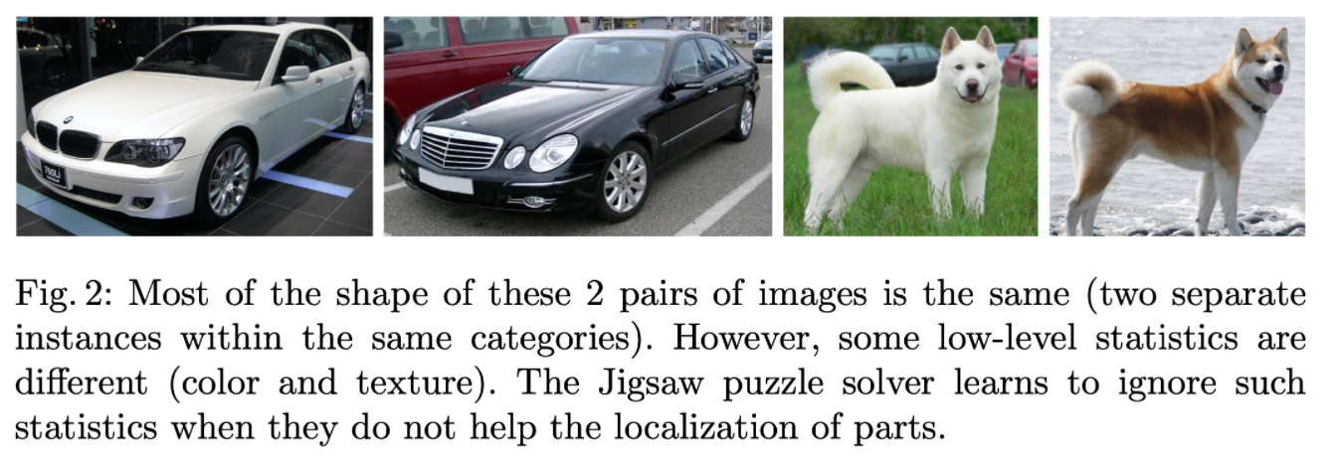
Brief Introduction of Paper
The Context Free Network (CFN), is designed to take picture tiles as input and output the correct spatial arrangement. This way, useful feature representation is learned and applied to a variety of transfer learning benchmarks (downstream tasks).
Conceptual Idea:
Two different-colored cars and two dogs with various fur patterns. Because they are invariant to shared patterns, the characteristics learned to solve puzzles in one (car/dog) image will also apply to the second (car/dog) image.

Slide 5
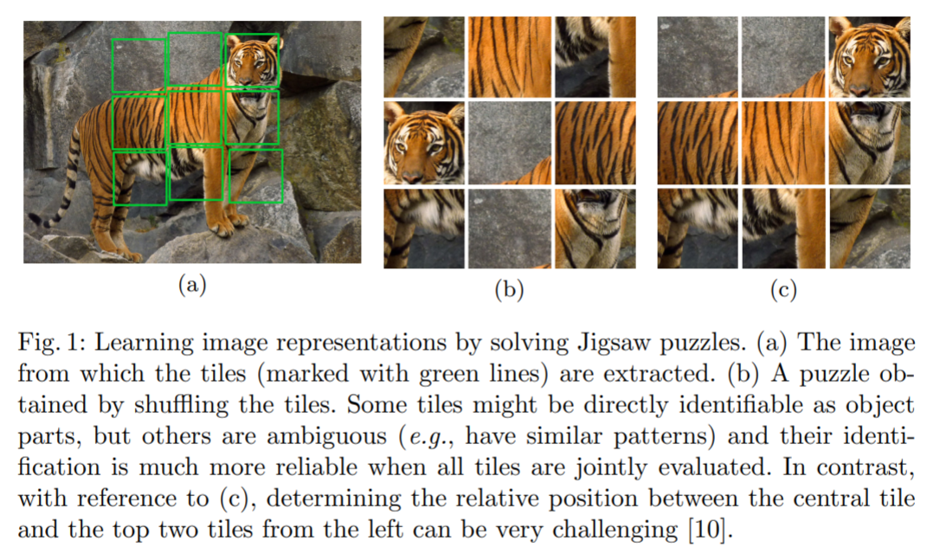
Brief Introduction of Paper
Notes:
This work is an unsupervised learning problem and falls in the field of representation/feature learning. The goal of representation learning is to create intermediate representations of data that may be used to perform machine learning tasks. It also involves transfer learning, in which one adapts and repurposes features learnt through Jigsaw puzzle solving to other tasks such as object classification and detection. Self-supervised learning make a distinction between labels that are easily accessible and are associated with a non-visual signal (for example, ego-motion, but also one could consider audio, text and so on), and labels that are obtained from the structure of the data.

Slide 6
Brief Introduction of Paper **
Brief description of how authors arrived at convolutional architecture that is capable to solve jigsaw puzzle is to stack the tiles of the puzzle along the channels (i.e., the input data would have 9×3=27 channels) and input these channels into a CNN to solve the Jigsaw puzzles. (Naïve Stacked Patches NOT Working)
The problem with this design is that the network prefers to identify correlations between low-level texture statistics across tiles rather than between the high-level primitives. A CNN with only low-level features learnt is NOT what we want.
**(Can be skipped)

Slide 7
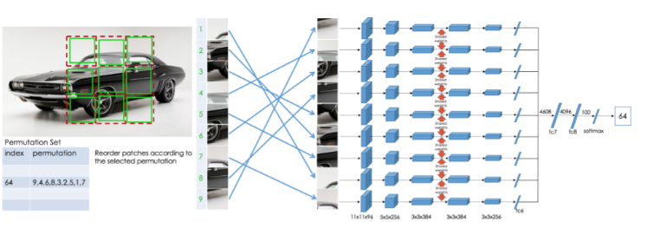
Paper Implementation Description
Notes:
The authors present a network that delays statistics computation across tiles. The network first computes features using only the pixels in each tile. Then, using only these features, it determines the part's arrangement. The goal is to force the network to learn features for each object part that are as representative and discriminative as possible in order to determine their relative location.
First, the Jigsaw puzzle is permuted before being fed into an AlexNet-like CNN.
Then, each patch/puzzle is processed by the CNN. In this case, puzzles in the network's early layers will NOT communicate with one another.
The weights are the same for each branch.
There are numerous permutation options. The goal is to correctly predict the index of the chosen permutation (technically, we define as output a probability vector with 1 at the 64-th location and 0 elsewhere).

Slide 8
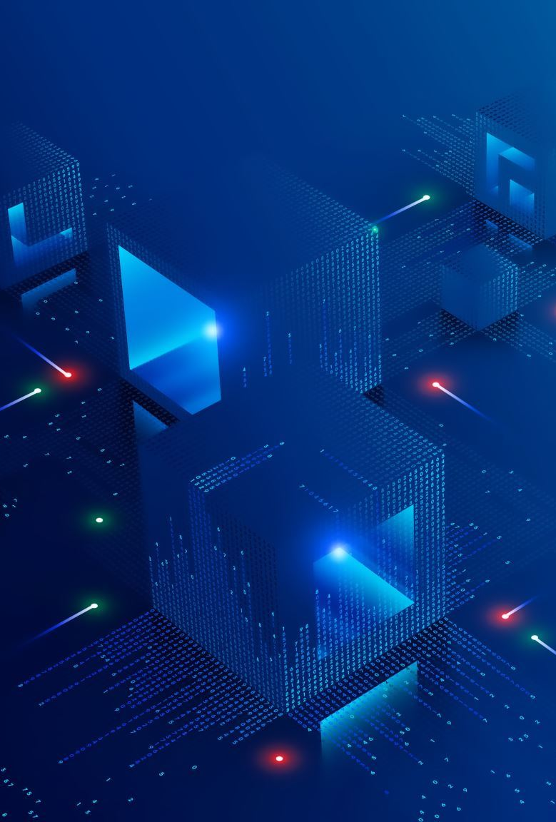
Paper Implementation Description
The given architecture is called context-free network (CFN) because the data flow of each patch is explicitly separated until the fully connected layer and context is handled only in the last fully connected layers.
GitHub Code Link : https://github.com/AryamannTomar/Project_JigSawPuzzleSolver

Slide 9

Network Framework Description
First, the Jigsaw puzzle is permuted before being fed into an AlexNet-like CNN.
Then, each patch/puzzle is processed by the CNN. In this case, puzzles in the network's early layers will NOT communicate with one another.
The weights are the same for each branch.
There are numerous permutation options. The goal is to correctly predict the index of the chosen permutation (technically, we define as output a probability vector with 1 at the 64-th location and 0 elsewhere).

Slide 10
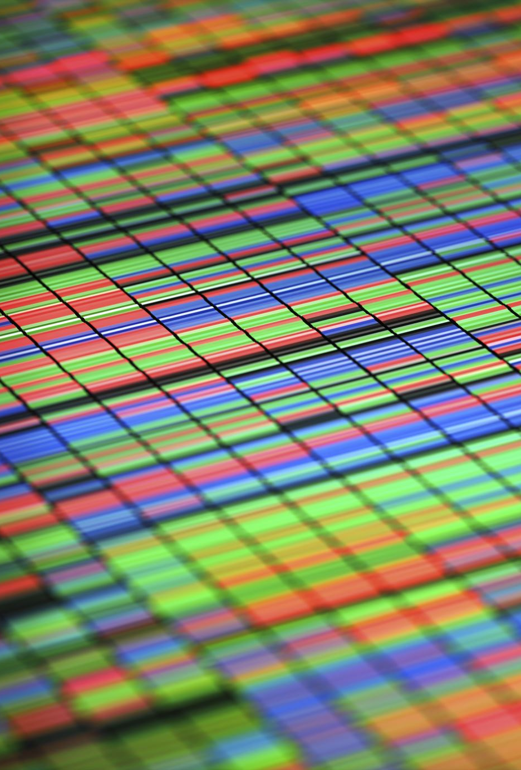
Network Training Description
During training, each input image is resized until either the height or the width matches 256 pixels and preserve the original aspect ratio. Then, a random region is cropped from the resized image of size 225×225 and is split into a 3×3 grid of 75×75 pixels tiles.
This network can thus be used interchangeably for different tasks including detection and classification.
This may sound simple but the paper presenters took 2.5 days to train on TitanX GPU. We trained on Ada by submitting it as batch job for 4 days.

Slide 11

Phases of our project work
Dataset loading : Trying out on small miniset and then on 170Gbs of ImageNet dataset. Yeah manipulating data was big problem!!
Creating the framework: We created a CFN model, and added layers of convolution, ReLU, etc.
Training: Setting the hyperparameters like learning rate, loss function, etc.

Slide 12
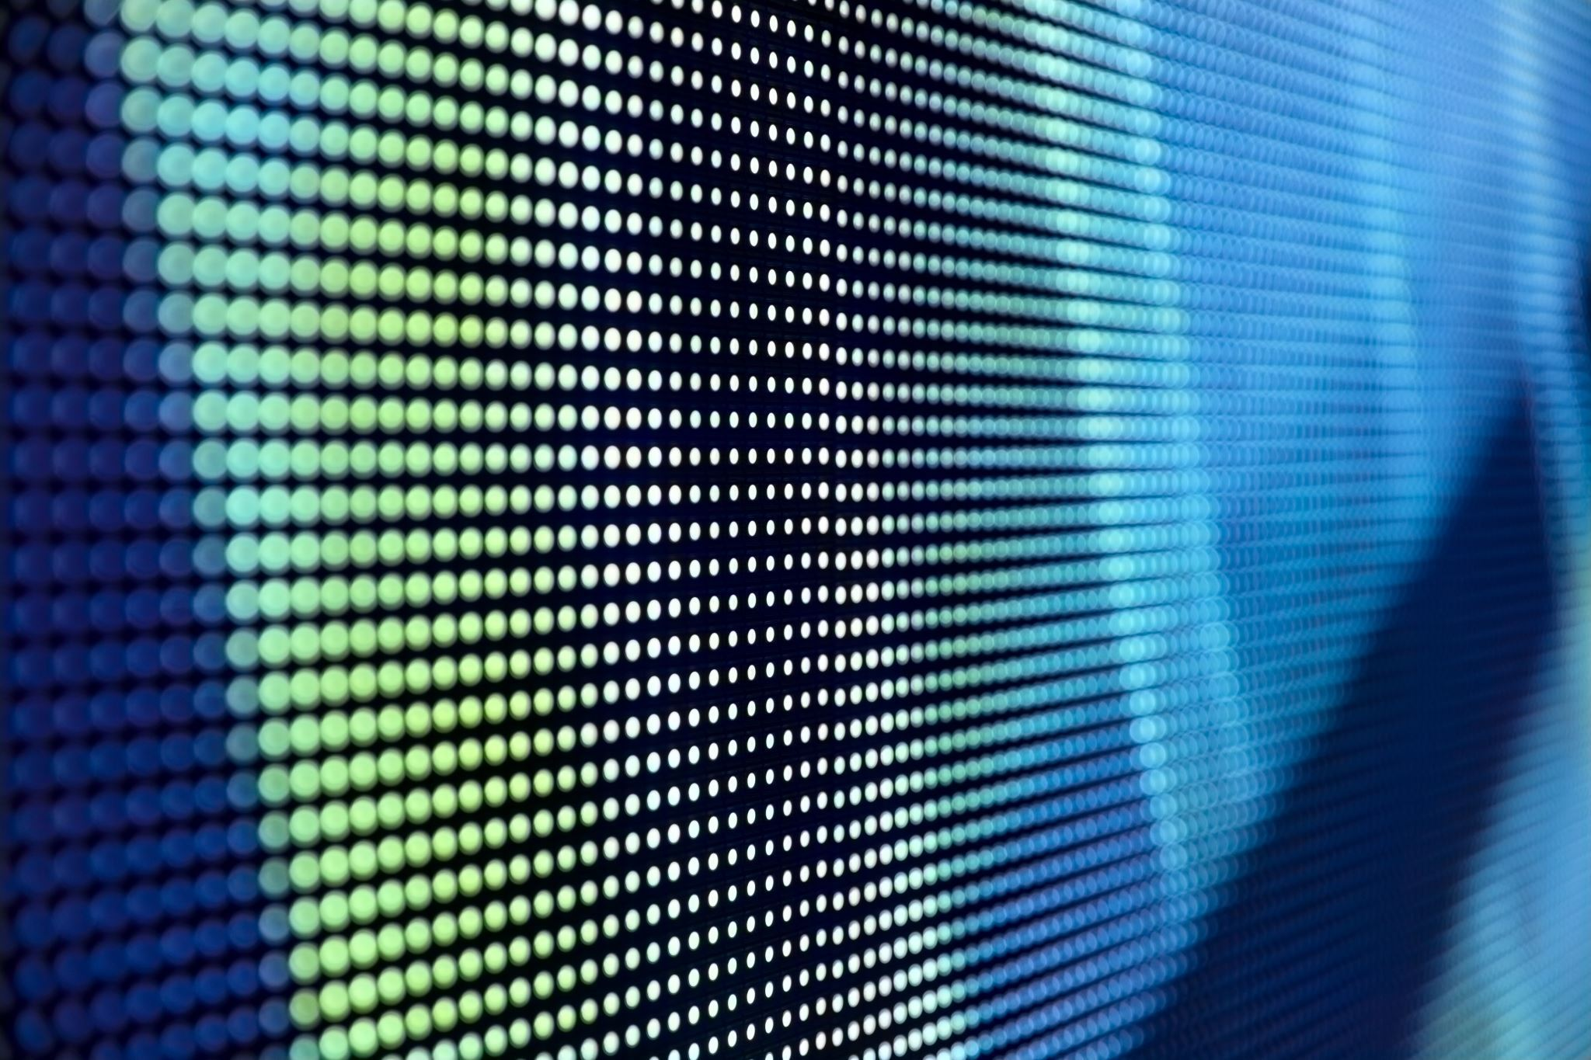
Dataset
We have used the ImageNeT 2012 dataset for our project.
It contains around 11 M images.
Link: https://image-net.org/challenges/LSVRC/index.php

Slide 13
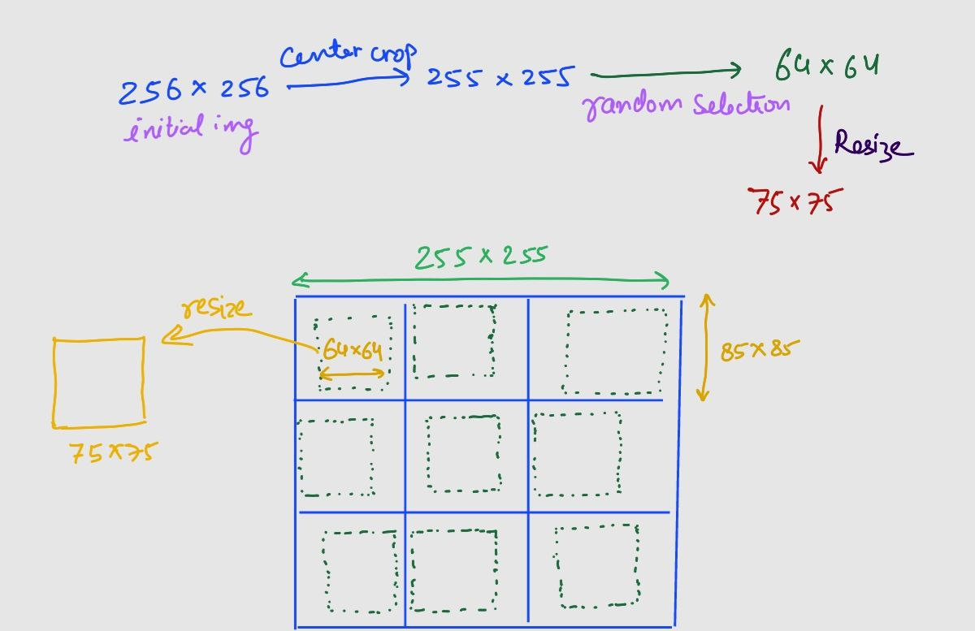
Generating Permutations
We generated all 9! possible permutations (only done once). Then we picked the best 1000 permutations based on maximizing the metric of Hamming distance and give each one a unique index.
Now, we permute the image randomly based on one of these 1000 permutations.

Slide 14
Framework
We have implemented a Context Free Network (CFN) which is like an AlexNet CNN.
Then we pass each patch/puzzle through our CFN.
These patches will not communicate with each other within the network layers until the last 3 fully connected layers. This is done to ensure that patches do not learn from each other, preventing the model from learning patterns in the images (low-level feature).
Each branch shares the same weights.
There are a lot of permutation choices. The task is to predict the index of the chosen permutation (technically, we define as output a probability vector of size 1000 with 1 at the i^{th} location and 0 elsewhere, where i is the index of the vector predicted).
Notes:
Mention LRN (Local Response Normalization) -> in the diagram

Slide 15
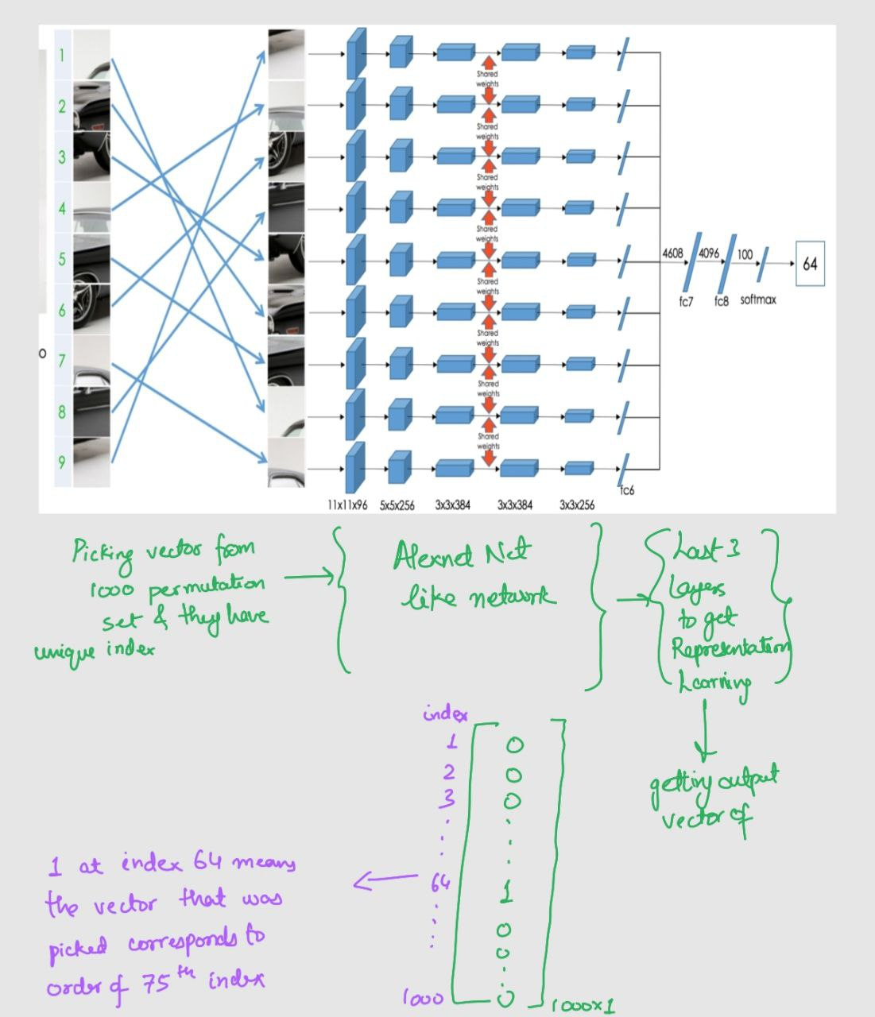
Notes:
Convolution, ReLU, maxpool, FC

Slide 16
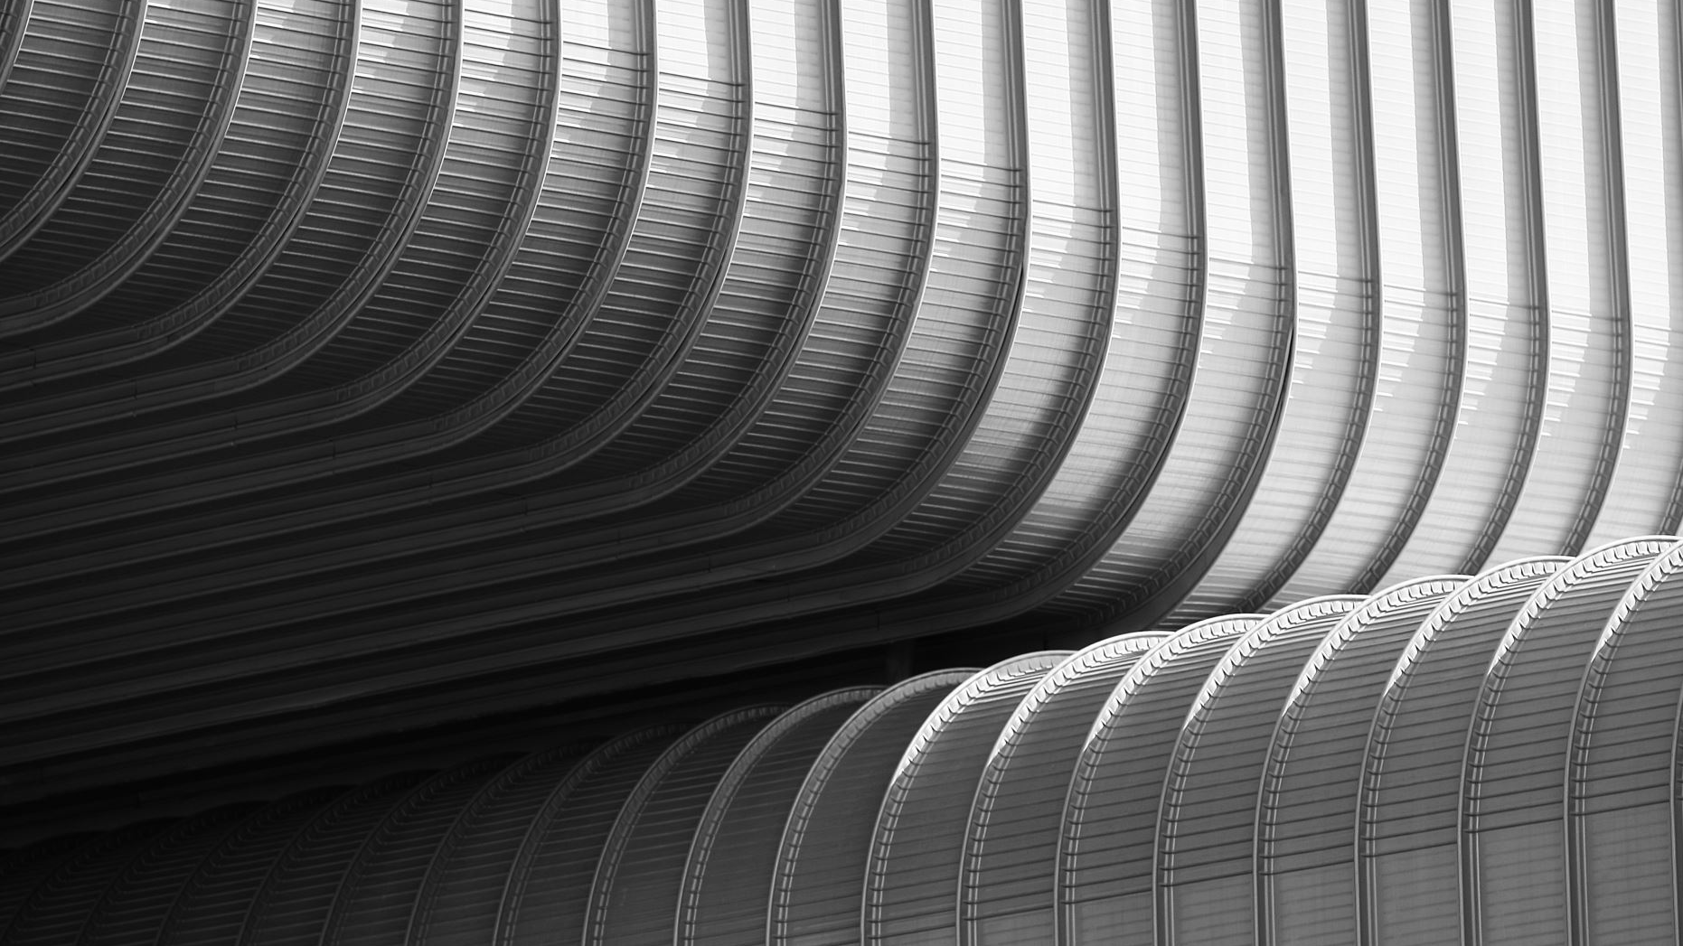
JigsawNetwork.py
Define a network (add layers Convolution, ReLU, max-pool).
1
Load the model.
2
Weight Initialization (Xavier normalization).
3
Forward propagation, load/create Checkpoints (saving various states of model).
4
Notes:
Add LRN after testing

Slide 17
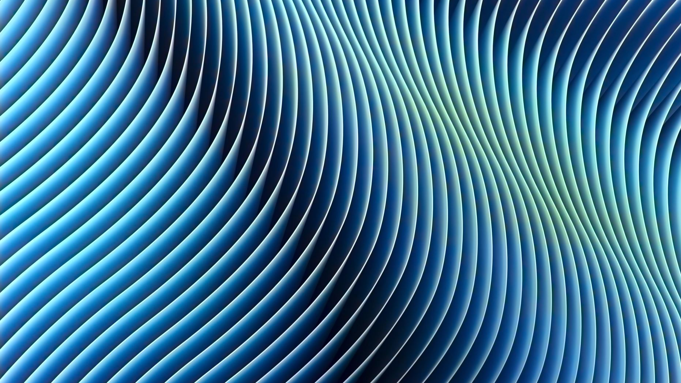
Training
Load train/test/validation data, define batch size = 128.
Learning rate (α) = 0.001
Loss function = Cross-Entropy Loss
Optimizer = Adam
No. of epochs = 70

Slide 18
Experiments/Analysis
Since, the validation loss was not decreasing during the validation phase, we tried out a few different experiments to try and figure out the problem:

Slide 19
Hyperparameters
Learning Rate (α)
We experimented with various learning rates to see if something was working xD.
The learning rates we tried were: {1e-3,1e-4,1e-2,1e-1}
None of these values for the learning rate seemed to reduce the training loss.
Something fishy seems to be happening in the code ….
Also, batch sizes of 128 and 64 were tried and none seemed to show any significant positive result.

Slide 20
Dataset Change : Checking Data loader part
MNIST
The first dataset we tried was the MNIST dataset.
However, the images from this dataset were stored in .csv format, so we had to read data of a particular buffer length from the file, and then manually reshape them, and then finally convert to .png format.
We divided the dataset into about ~ 40000 images for the training set and ~ 10000 images for the validation set.

Slide 21
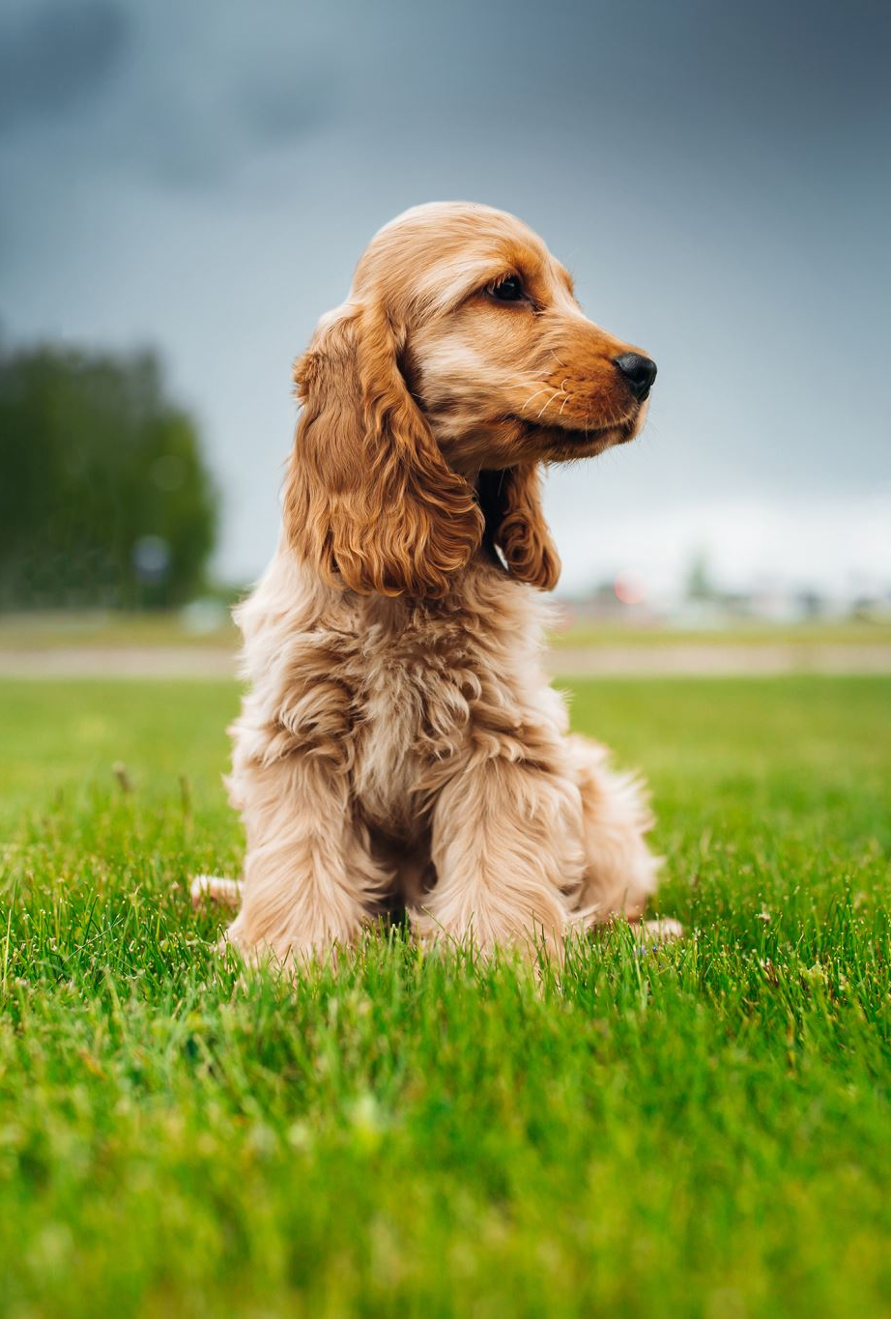
Dataset Change : Checking Data loader part
Smaller ImageNet dataset
We also tried training our model on a single class dataset of Dog's images obtained from Image NET consisting of ~ 16000 images for the training set, and ~ 2000 images for the validation set.
Permutation and reordering of the images seemed to work well so it ensures that Dataset loader section was correct, and we need to verify the network.

Slide 22
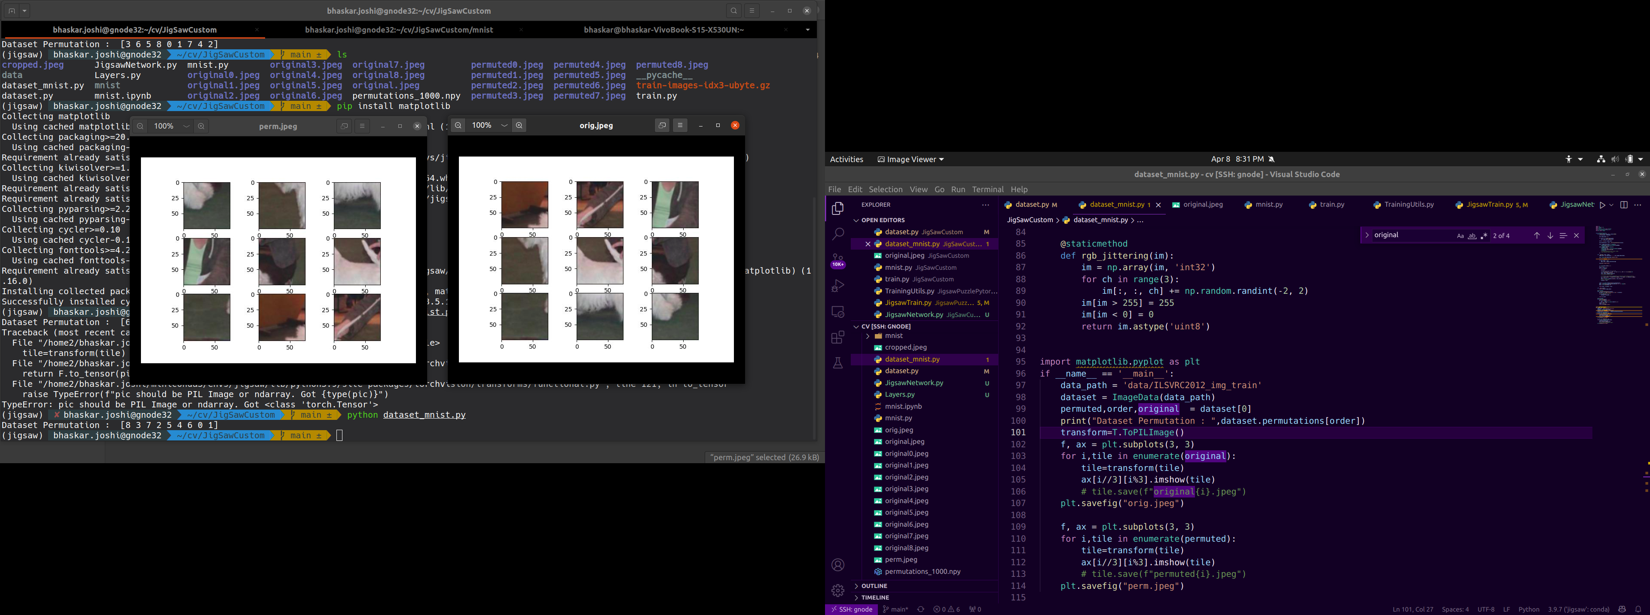

Slide 23

LRN (Local Response Normalization) Layer: Changes to Network
The reason we may want to have normalization layers in our CNN is that we want to have some kind of lateral inhibition scheme, where an excited neuron subdues its neighbors. This results in a significant peak so that we have a form of local maxima.
ReLU neurons have unbounded activations and we need LRN to normalize that. We want to detect high frequency features with a large response. If we normalize around the local neighborhood of the excited neuron, it becomes even more sensitive as compared to its neighbors.
At the same time, it will dampen the responses that are uniformly large in any given local neighborhood, and boost the neurons with relatively larger activations.

Slide 24
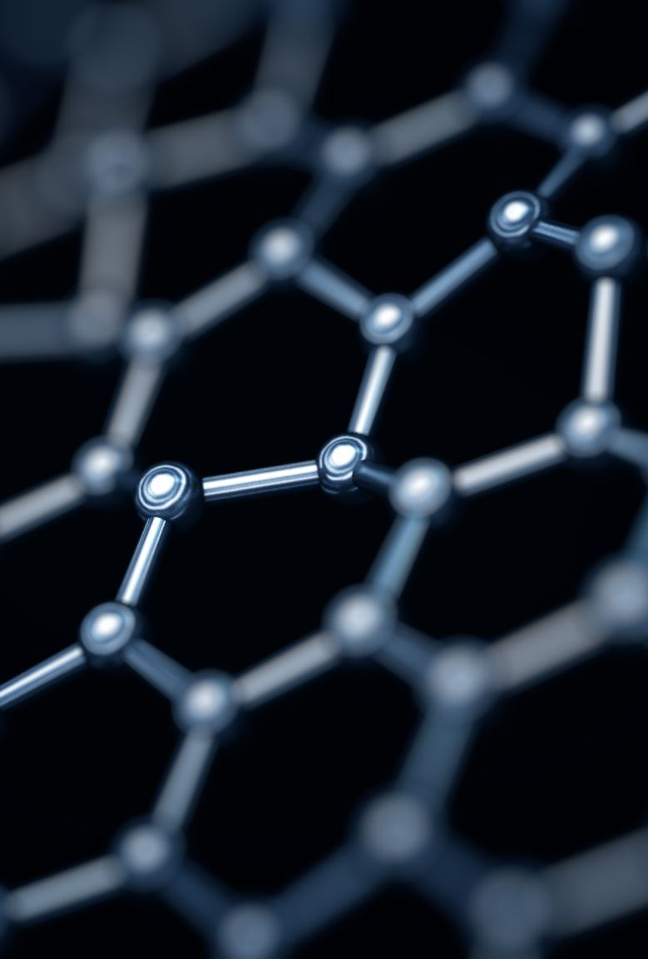
LRN (Local Response Normalization) Layer
LRN can be performed within the same channel or across multiple channels.
In our code, we tried Response Normalization within the same channel.

Slide 25
Transfer Learning
We tested model by importing AlexNet model from Pytorch as it was already per-trained on the existing ImageNet dataset.
The next thing we tried was to freeze the weights of AlexNet model and then try training.
But this also didn’t give us any useful output.

Slide 26
Trying out GitHub Code
Next thing was to find some online implementation of the paper.
Their code was in python 2.7 and there was some conflict in version of pytorch and tensorflow while making conda environment.
There was an issue with dataloader part of github code as it was choosing some custom and existing dataset images so we needed to tweak it accordingly.
Next, we trained out on small dataset of github's implemendation and found that their code was not converging and so we trained it for 4 days on Imagenet dataset.

Slide 27
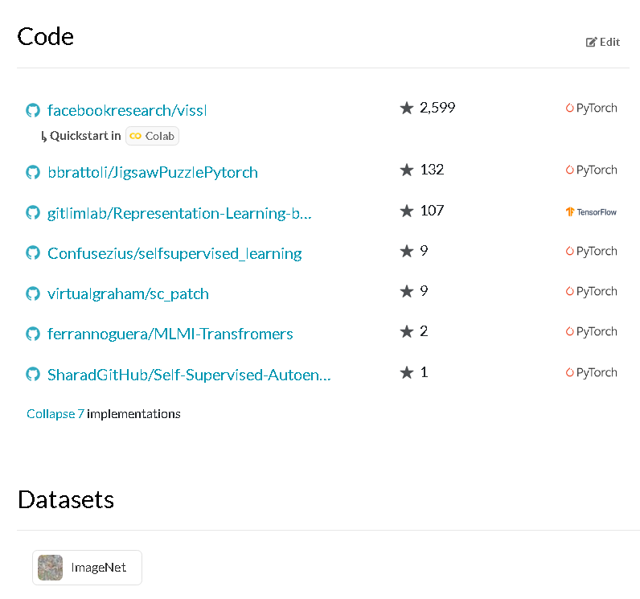
Trying out GitHub Code

Slide 28
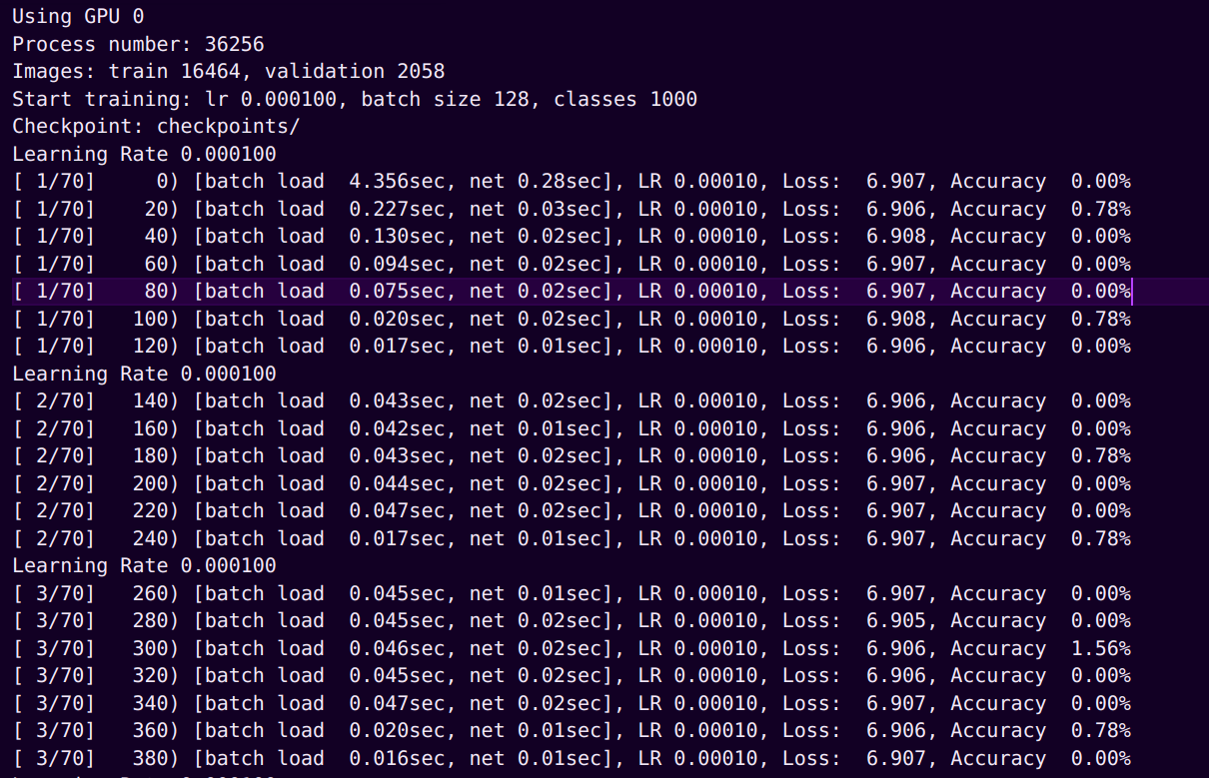
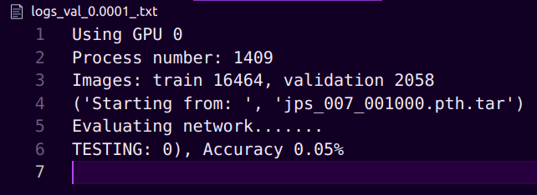
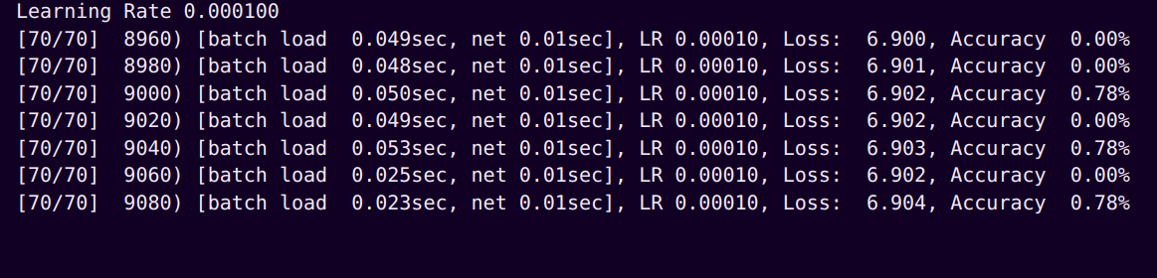
Author's Train Loss
Author's Validation Loss​

Slide 29
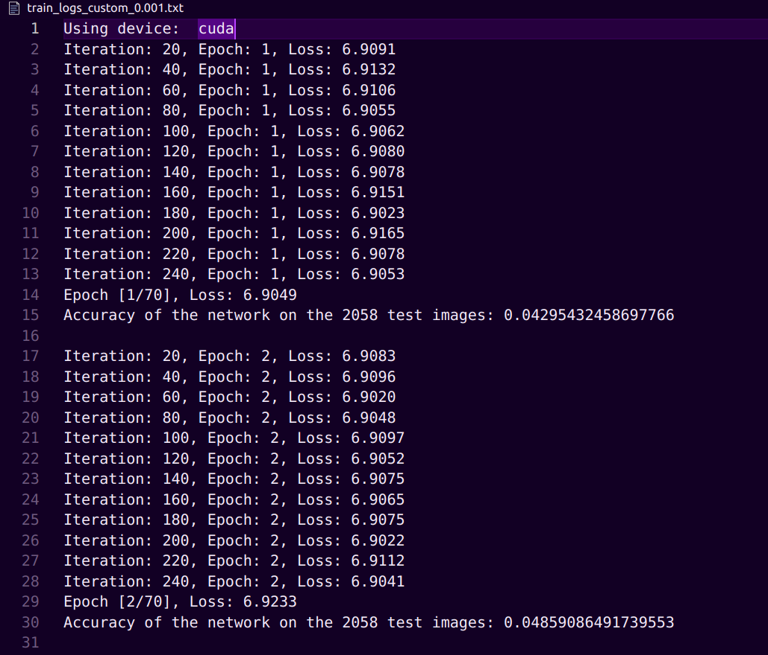
Our Train and Validation Loss (initial)
- implemented without the AlexNet pre-trained model

Slide 30
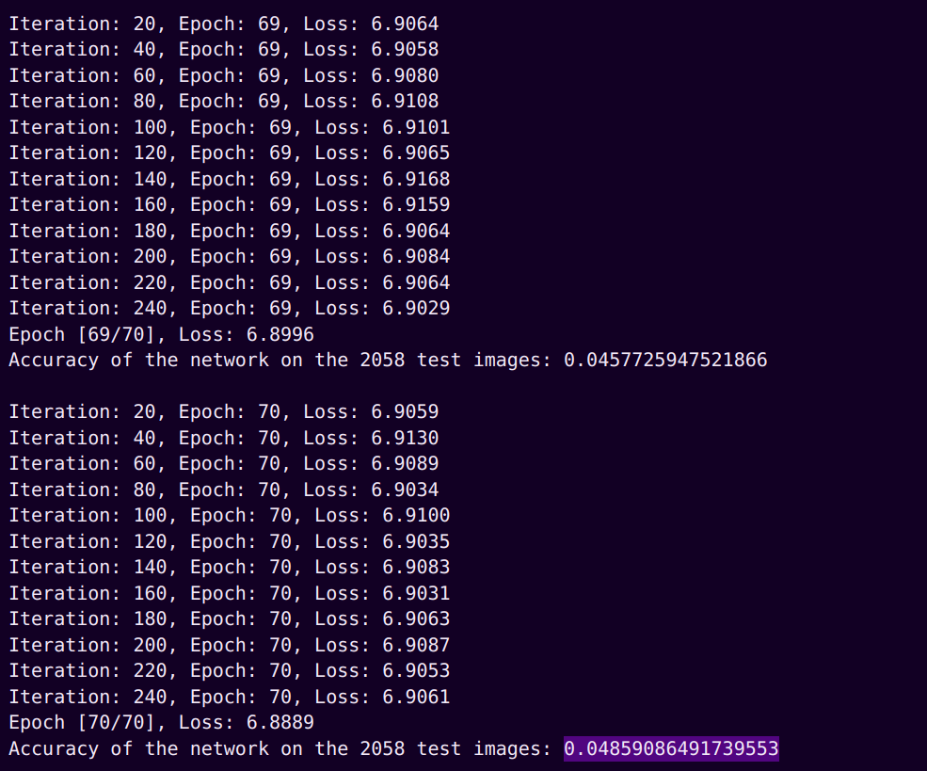
Our Train and Validation Loss (initial)

Slide 31
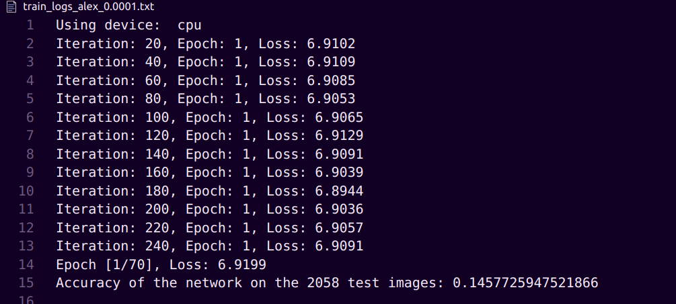
AlexNet Training Loss and Accuracy

Slide 32
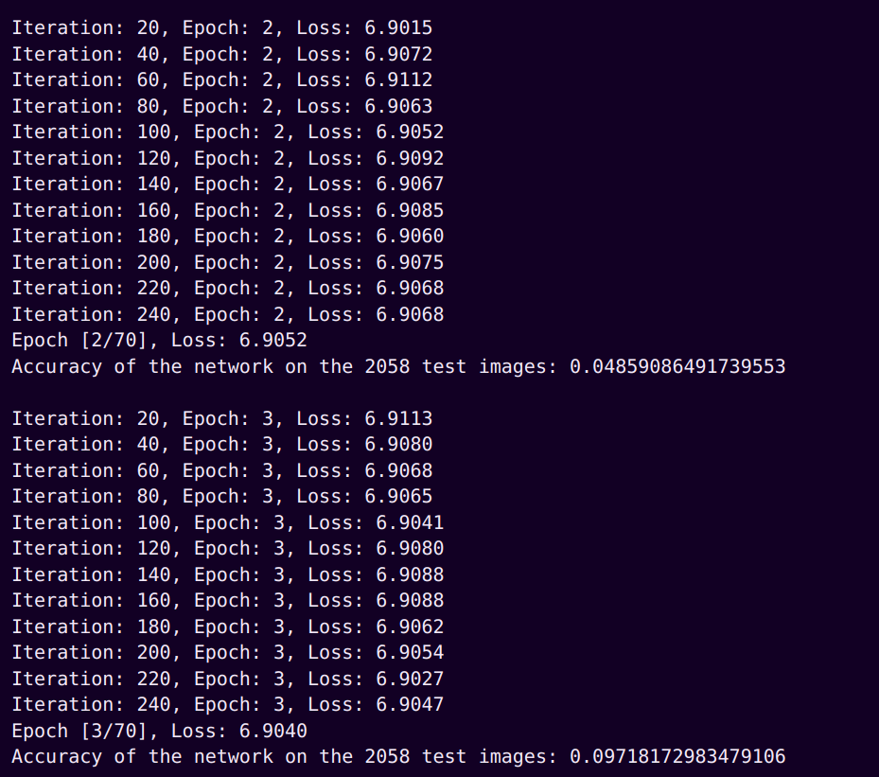
AlexNet Training Loss and Accuracy (with frozen weights)

Slide 33
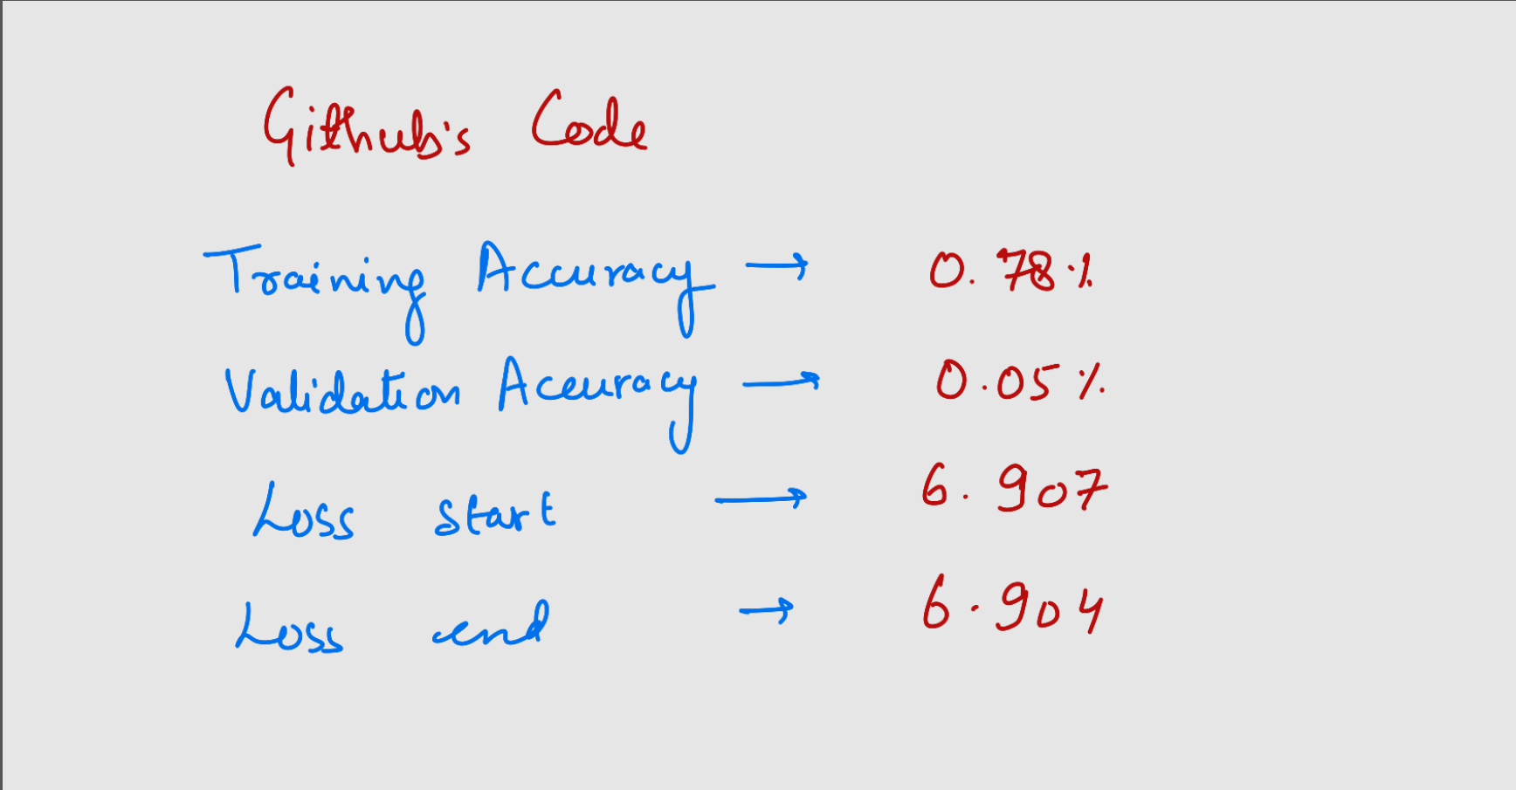
Comparisons

Slide 34
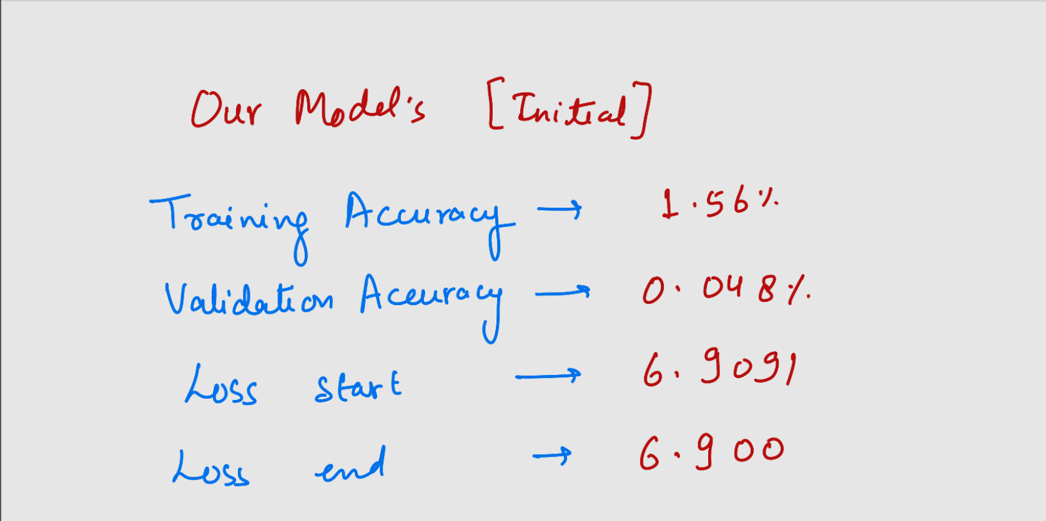
Comparisons

Slide 35
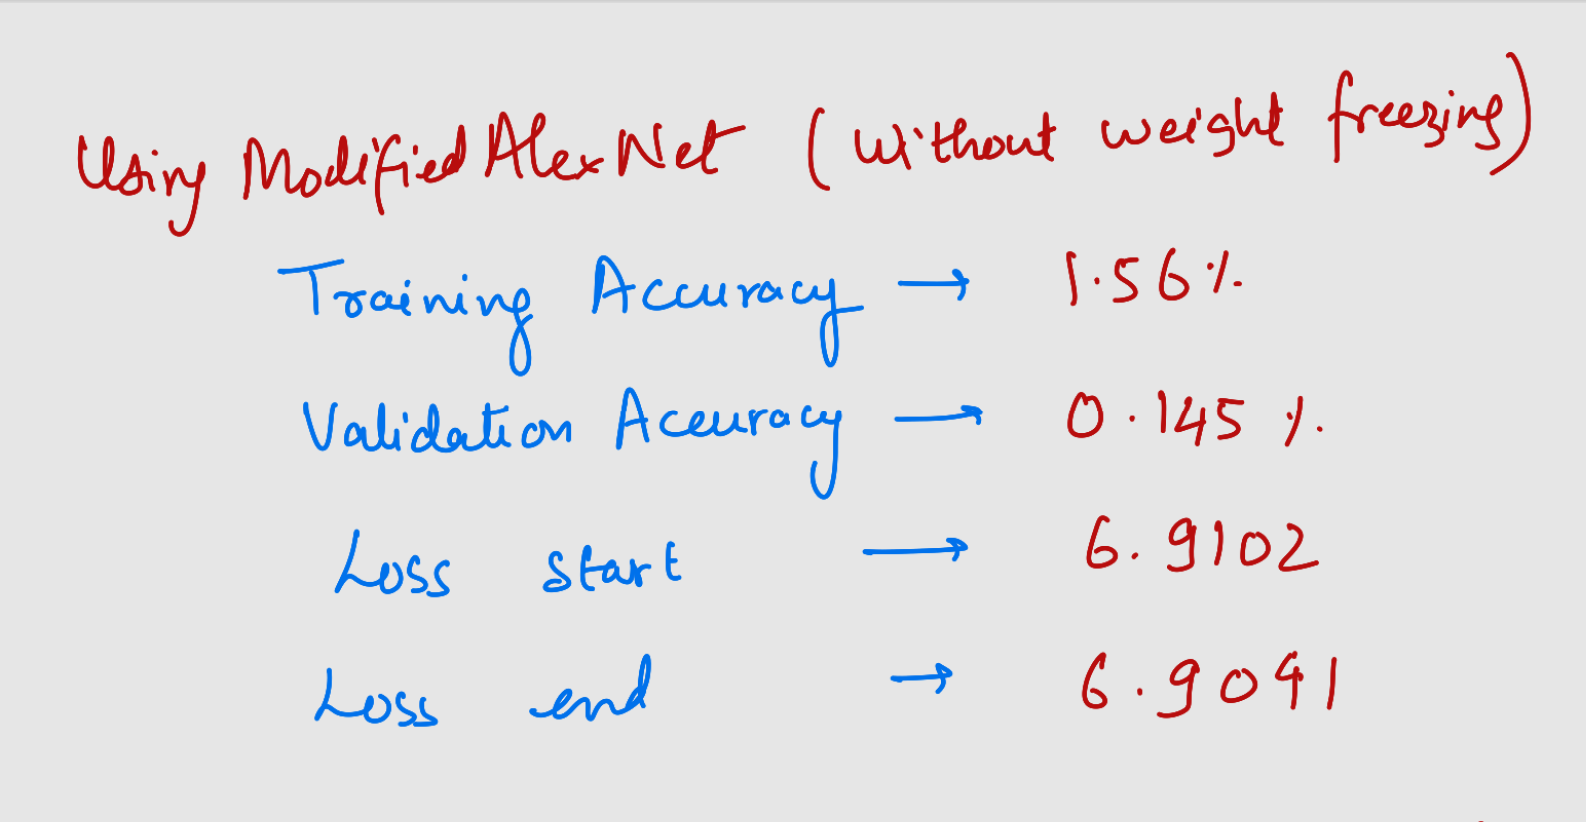
Comparisons

Slide 36
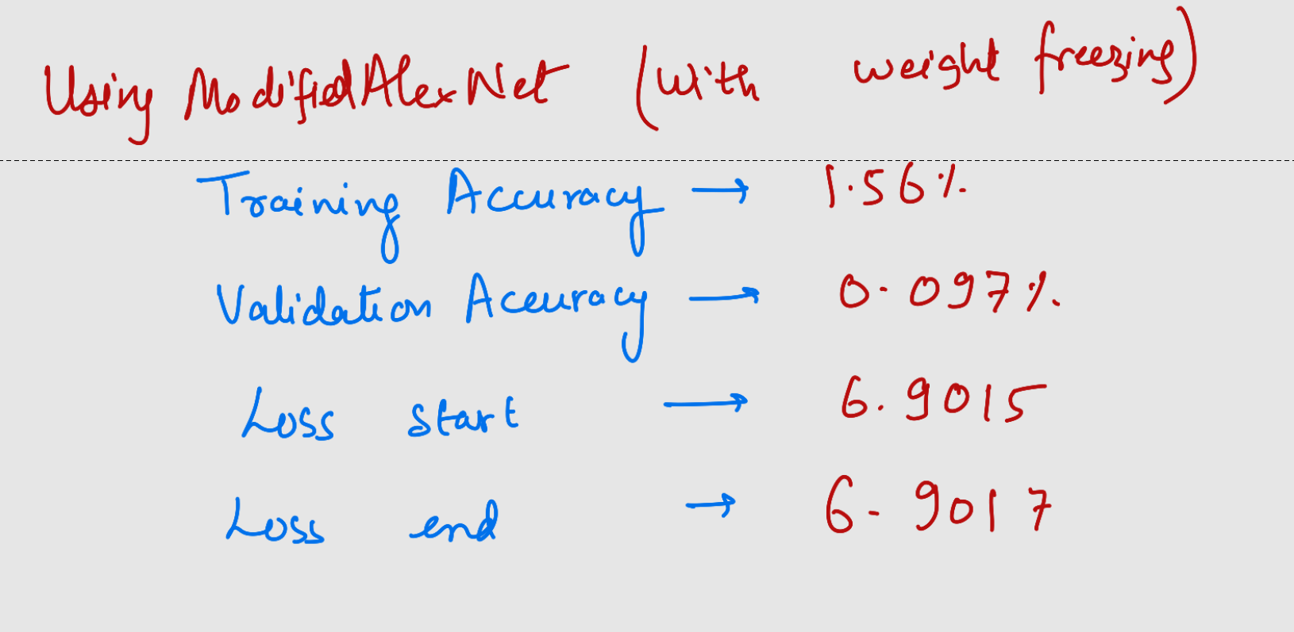
Comparisons

Slide 37
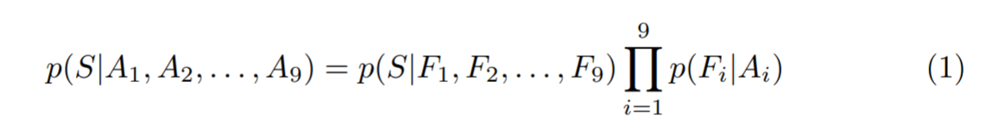
Avoiding Shortcuts
Feature association with position: The CFN may accidentally learn to associate features with absolute positions if only 1 Jigsaw puzzle is generated per image.
This shortcut can be avoided by feeding the CFN multiple Jigsaw puzzles of the same image, making sure that tiles are shuffled as much as possible and have adequately large average Hamming distance, ensuring that the same tile can be assigned to multiple positions within the grid and avoiding the correlation of an absolute position.
Notes:
The following equation illustrates how the conditional pdf can be factorised into independent terms by writing the configuration S as a list of tile positions.

Slide 38
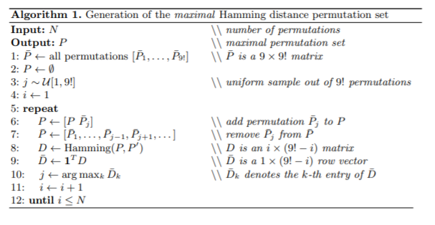

Slide 39
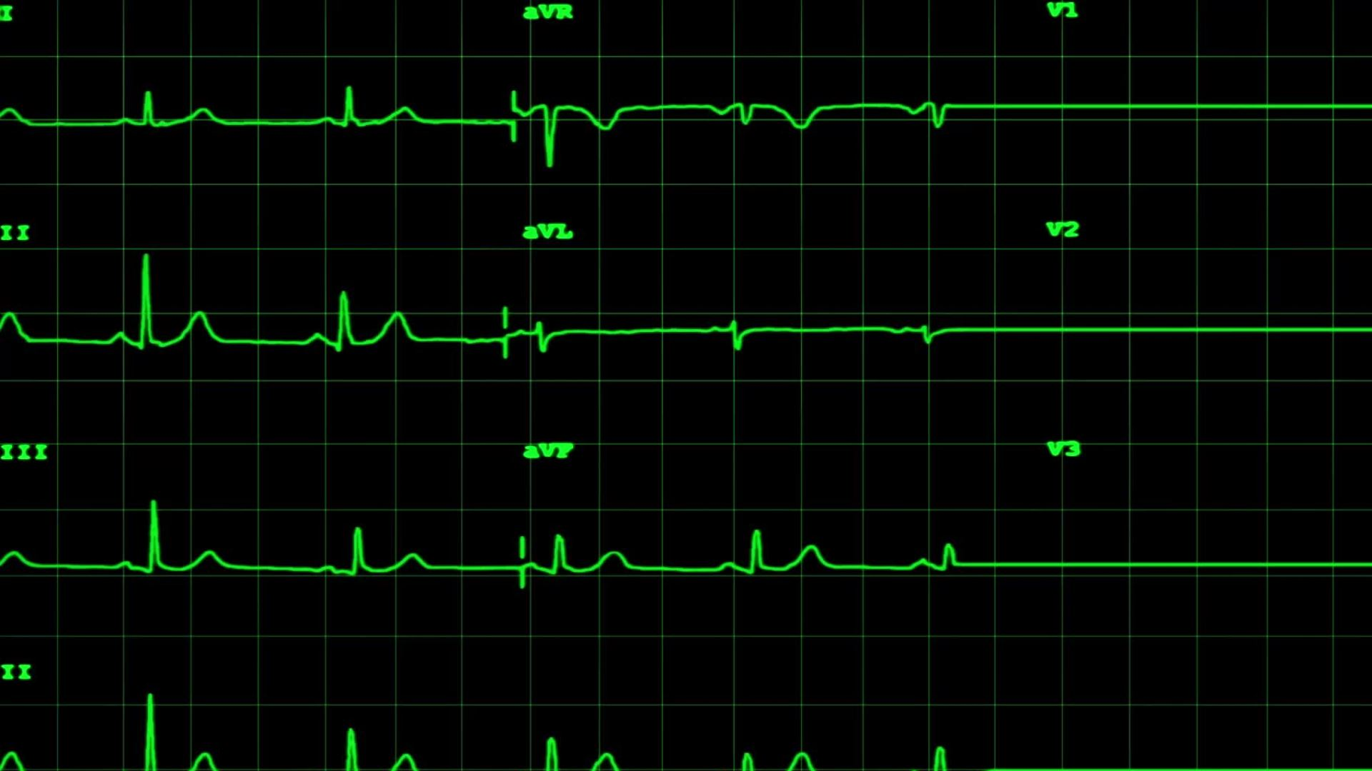
Avoiding Shortcuts
Low-Level Statistics: These can include the mean and start deviation of the pixel intensities, allowing the model to determine the patch arrangement. As a result, the mean and standard deviation are normalized for each patch.
Edge Continuity: Another shortcut is for the CFN to become aware of edge continuity and pixel intensity distribution. By addressing this issue, the CFN does not learn low-level statistics. This includes resizing input images and cropping a random region to leave random gaps between tiles ranging in size from 0 to 22 pixels. A 21-pixel gap between tiles is achieved by randomly selecting 64x64 pixel tiles from the 85x85 pixel cells.

Slide 40
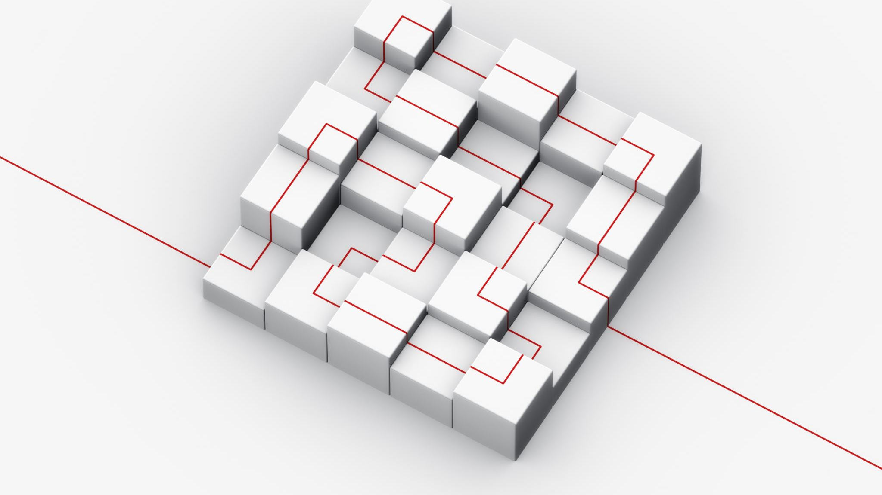
Avoiding Shortcuts
Chromic Aberration: A third shortcut can be attributed to chromatic aberration, which is a relative spatial shift between colour channels that increases from the center images to the borders, assisting the network in estimating the tiles. This is resolved by cropping and resizing the original image's central square, training with both colour and grayscale images, jittering colour channels, and using greyscale images.

Slide 41
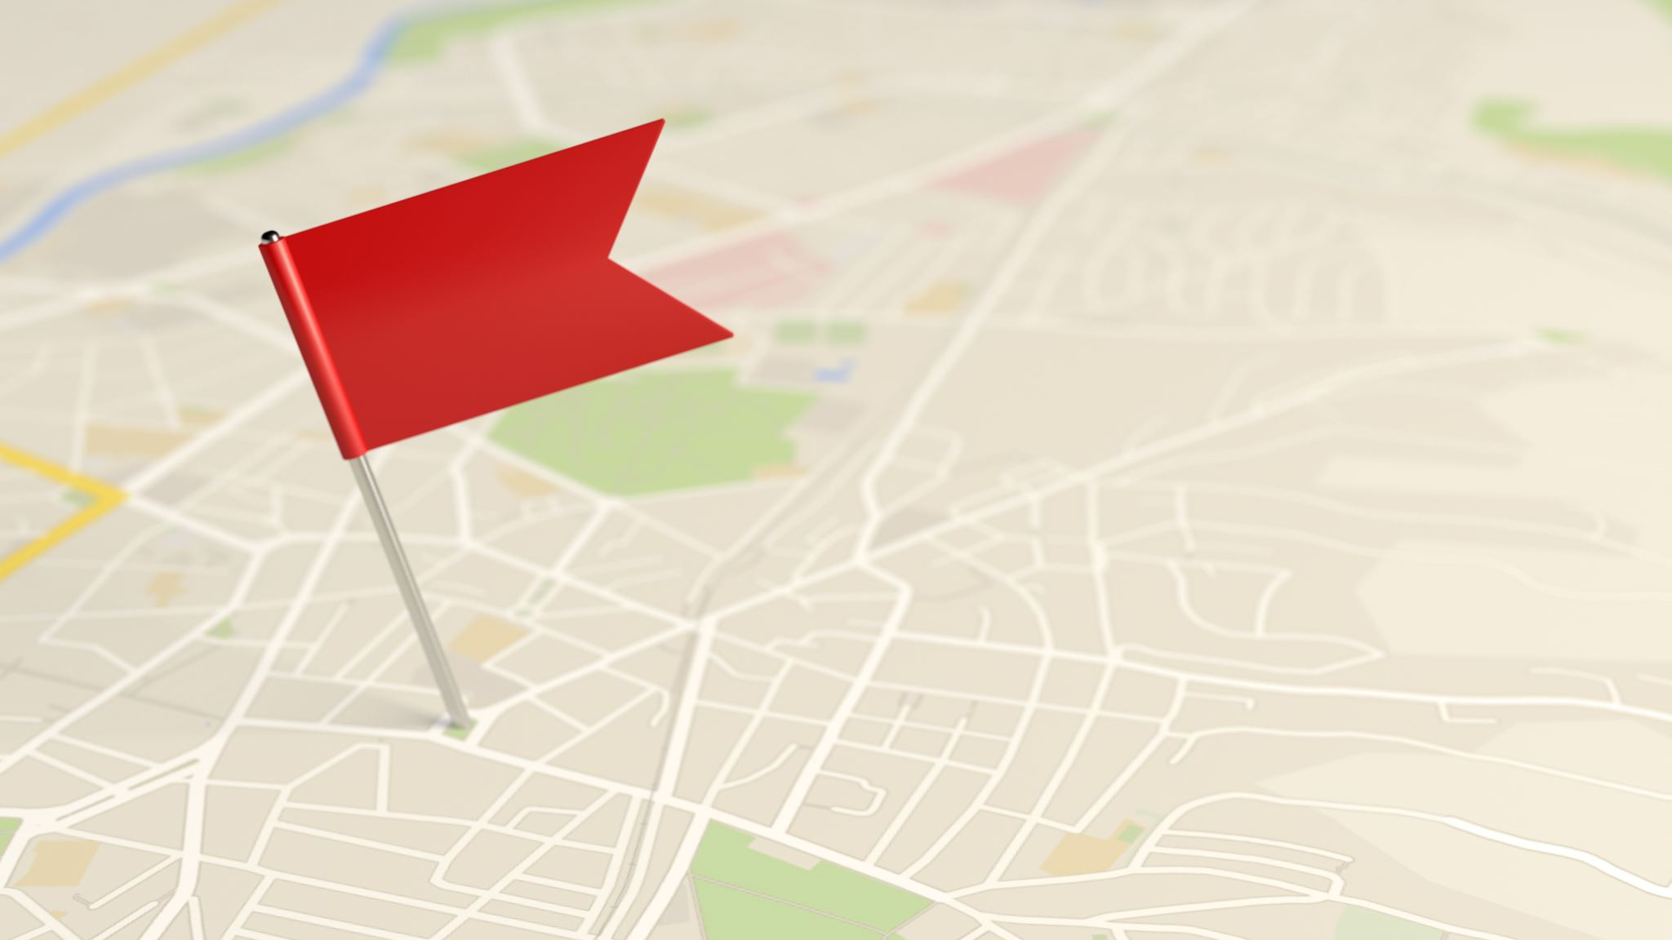
Some References
https://arxiv.org/pdf/1603.09246v3.pdf
https://paperswithcode.com/paper/unsupervised-learning-of-visual-1#code
https://towardsdatascience.com/difference-between-local-response-normalization-and-batch-normalization-272308c034ac
https://towardsdatascience.com/transfer-learning-using-pre-trained-alexnet-model-and-fashion-mnist-43898c2966fb

